Slide 1

BUSINESS
NEEDS AND
BUSINESS
REQUIREMENTS
PRESENTED BY:
GROUP 7

Slide 2

CONTENT
Overview
Goal
Objective
Present and Future of LMS
Assumptions and Gap
Process Map
Team
REALLYGREATSITE.COM

Slide 3
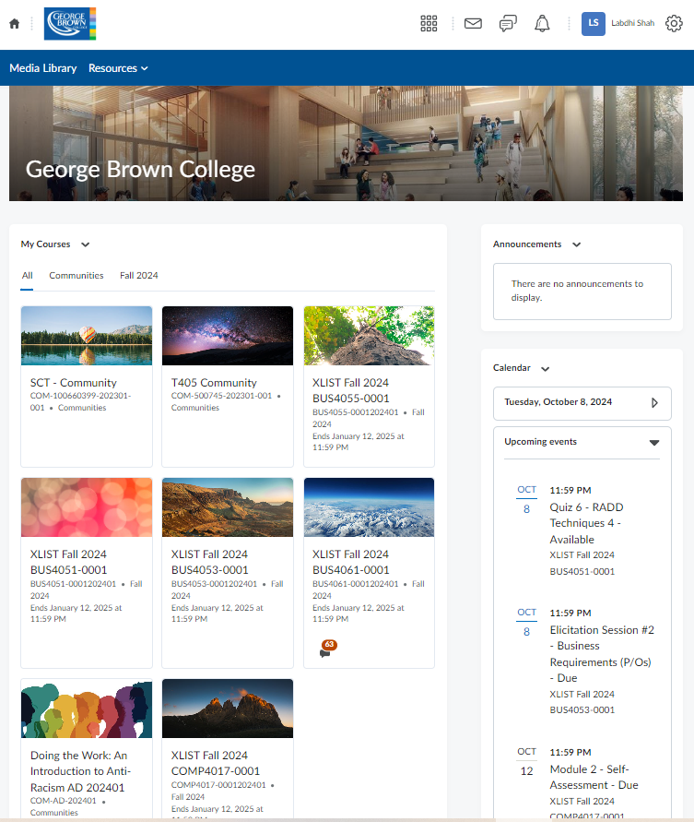
OVERVIEW
Brightspace is a cloud-based Learning Management System (LMS) designed by D2L. It offers tools for course creation, content delivery, assessments, and student tracking.
FUNCTIONALITY
Managing Users and Teams
(All processes and actions related to user allocation to course, team set-up, and team performance (tracking, submission of team assignments, reporting, etc.)

Slide 4

GOAL
Streamline User Allocation: Ensure student and faculty are assigned to the appropriate course, minimizing administrative delays and errors.
Optimize Team Set-up and Collaboration: Implement an efficient process for creating and managing teams within courses, offering customizable roles and fostering effective collaboration.
Enhance Team Performance Tracking and Automation: Enable clear visibility of team submissions, progress, and individual contributions, while streamlining reporting and automating feedback between instructors and students.

Slide 5

OBJECTIVES
Decrease the time required to allocate users to teams by 15% within the next 3 months to enhance efficiency in team setup.
Implement a system that tracks team performance with 95% accuracy within 6 months, ensuring clear visibility of progress and contributions.
Integrate both objectives to streamline team management and improve overall tracking and reporting efficiency by the 6-month mark.

Slide 6

PROBLEMS
Time Delays: User allocation takes too long, especially when dealing with large numbers of users.
Manual Errors: Team performance tracking and reporting involve manual entry, which often leads to mistakes.
Lack of Automation: Submitting team assignments and tracking performance is not automated, causing delays and errors.

Slide 7
CURRENT PROCESS FLOW
1
User Allocation: Admin manually assigns users to courses and teams.
2
Team Setup: Admin and team leaders communicate to set up teams.
3
Team Assignment Submission: Users submit their work manually through the system.
4
Performance Tracking: Team performance is tracked using spreadsheets and manual reporting.
5
Reporting: Team performance reports are submitted monthly by course coordinators.

Slide 8
CURRENT PROCESS FLOW
Allocate Users
Analyze Report
Admin
Start
End
Course Coordinator
Confirm Allocation
Track Team Performance
Submit Report
Submit team assignments
Users

Slide 9





OPPORTUNITIES
AUTOMATE COURSE ENROLLMENT AND TEAM FORMATION
Improve the process of user allocation and team setup to save time and reduce errors.
AUTOMATE REPORTING
Use automation to generate detailed reports on team performance, assignments, and participation with minimal instructor involvement.
DEVELOP PERFORMANCE DASHBOARDS
Create visual tools that provide real-time data on team and individual performance, making it easier to track progress.
INTRODUCE TEAM COLLABORATION TOOLS
Implement features like shared documents, discussion forums, and task tracking to foster better collaboration.

Slide 10
METRICS:
Reduce the time from student registration to successful course allocation by 15% and track a 95% success rate in team creation within 24 hours of course initiation.
Track a 90% on-time submission rate for team-based projects and measure a 30% reduction in the time instructors spend manually generating performance reports.

Slide 11
TEAM MEMBERS
Labdhi Shah - 01550197
Parbon Banerjee-101469825
Nishita Ahuja - 101540366
Musaab Shirgar - 101490106
Shilpa Sosa George - 101547819
Muhammad Asad Bin Faruq - 101552479
Aditya Kapoor - 101564423

